Slide 1
SECURE DATA HIDING IN IMAGES USING STEGANOGRAPHY
CAPSTONE PROJECT
Presented By: Mohamed Raashidh H
Student Name : Mohamed Raashidh H
College Name & Department : Muthayammal Engineering College (Autonomous), Namakkal & B.Tech IT

Slide 2
OUTLINE
Problem Statement
Technology used
Wow factor
End users
Result
Conclusion
Git-hub Link

Slide 3
Problem Statement
With increasing digital communication, securing sensitive data is crucial. Traditional encryption methods can be vulnerable, while steganography offers a covert way to hide messages. This project embeds confidential messages in images, ensuring only authorized users can decrypt them using a passcode. A user-friendly Python-based GUI integrates OpenCV and PyQt6 for secure and efficient encryption and decryption.

Slide 4
Technology used
Programming Language: Python
Libraries Used
Graphical User Interface (GUI): PyQt6
Image Processing: OpenCV
Data Handling: NumPy
Encryption & Steganography: Pixel-based data embedding
platform: Windows

Slide 5
Wow factors
🔹 Steganography + Encryption: Combines both techniques for double-layer security. 🔹 Invisible Data Embedding: Hides messages in image pixels without altering visibility. 🔹 Passcode Protection: Only authorized users can decrypt the message. 🔹 User-Friendly Interface: Simple GUI using PyQt6 for easy encryption & decryption. 🔹 No External Storage Required: Data is embedded within the image itself, reducing risks.

Slide 6
End users
🔹 Individuals – People who want to securely store or share confidential messages. 🔹 Journalists & Whistleblowers – Safeguard sensitive information from surveillance. 🔹 Government & Defense Agencies – Secure classified communications. 🔹 Corporate Professionals – Protect business secrets and confidential data. 🔹 Cybersecurity Enthusiasts – Learn and explore encryption & steganography.

Slide 7
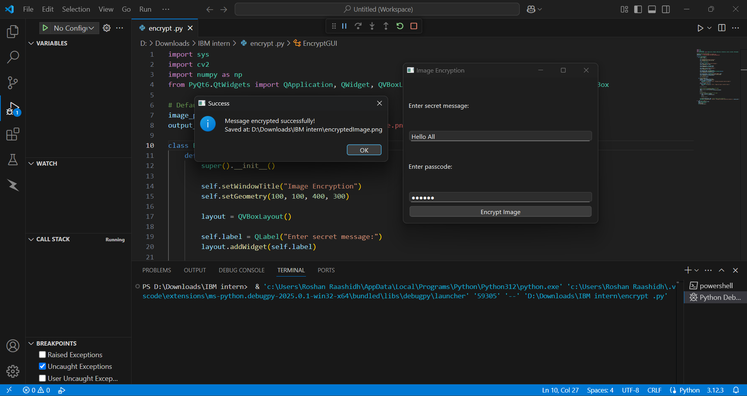
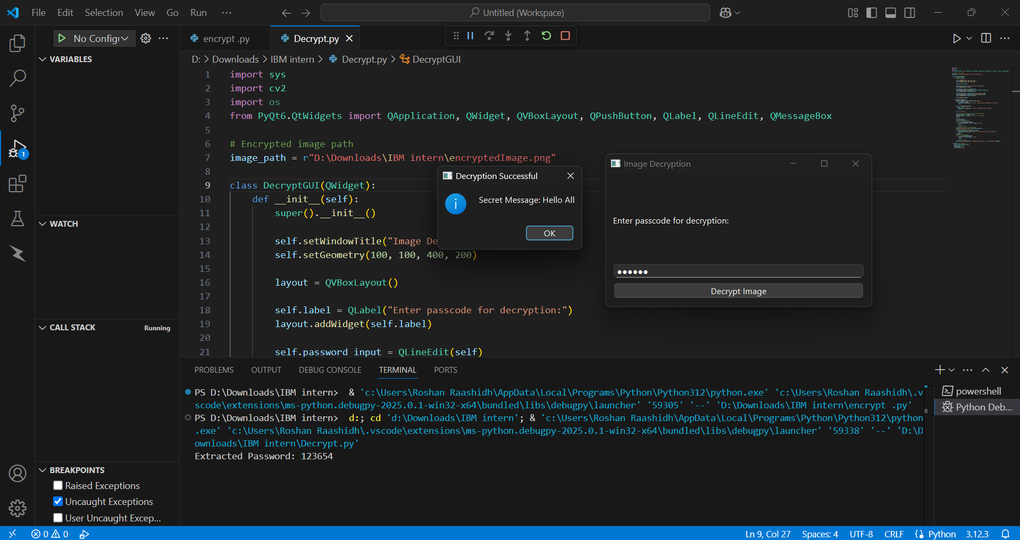
Results

Slide 8
Conclusion
This project successfully addresses the challenge of securely transmitting confidential information by integrating encryption and steganography. It ensures data secrecy by embedding messages within images while maintaining their appearance. With passcode protection and a user-friendly GUI, only authorized users can decrypt the hidden data. By leveraging Python, OpenCV, and PyQt6, the project provides a secure, efficient, and accessible solution for private communication.

Slide 9
GitHub Link
https://github.com/Raashidh17/Secure-Data-Hiding-in-Images-using-Steganography.git

Slide 10
THANK YOU

